Slide 1
C# & .NET Framework
Chapter 19:
Programming With Windows Forms Control

Slide 2
Review
Object Serialization: the process of persisting the state of an object to a stream
Configuring Objects for Serialization: [Serializable], [NonSerialized]
Serializing Objects Using the BinaryFormatter
Serializing Objects Using the SoapFormatter
Serializing Objects Using the XmlSerializer.

Slide 3
Chapter 19: Objectives
Overview of the System.Windows.Forms Namespace.
Working with the Windows Forms Types
The Role of the Application Class
The Anatomy of a Form
The Functionality of the Control Class
The Functionality of the Form Class.
Building Windows Applications with Visual Studio 2005
Working with MenuStrips and ContextMenuStrips.
Working with StatusStrips.
Working with ToolStrips
Building an MDI Application

Slide 4
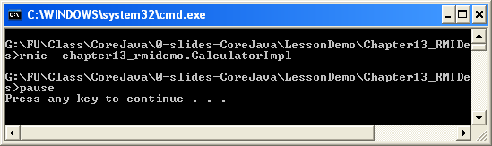
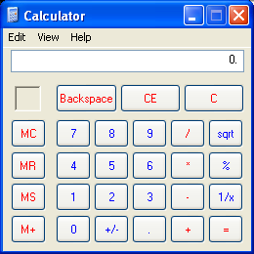
Introduction
Console App.
Event-based App.
(GUI)
Event object
Even handling
User
Update GUI

Slide 5
System.Windows.Forms Namespace
Core infrastructure: represents the core operations of a .NET Forms program (Form, Application, etc.) and various types to facilitate interoperability with legacy ActiveX controls.
Controls: used to create rich UIs (Button, MenuStrip, ProgressBar, DataGridView, etc.), all of which derive from the Control base class. Controls are configurable at design time and are visible (by default) at runtime.
Components: These types do not derive from the Control base class but still provide visual features to a .NET Forms program (ToolTip, ErrorProvider, Timer, etc.).
Common dialog boxes: Windows Forms provides a number of dialog boxes for common operations (OpenFileDialog, PrintDialog, etc.).

Slide 6
System.Windows.Forms
Some Core Types
Classes
Application
Button, CheckBox, ComboBox, LinkLabel, MaskedTextBox, LinkLabel, MaskedTextBox, MonthCalendar, PictureBox, TreeView
ColorDialog, OpenFileDialog, SaveFileDialog, FontDialog, FolderBrowserDialog
Menu, MainMenu, MenuItem, ContextMenu, MenuStrip, ContextMenuStrip
StatusBar, Splitter, ToolBar, ScrollBar, StatusStrip, ToolStrip
(More on page 659)

Slide 7
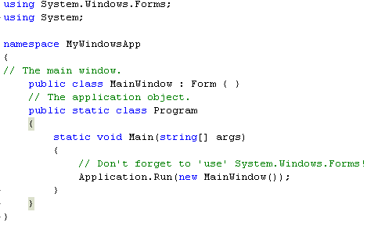
Building first Windows application
MyWindowsApp.cs
Notes:
Application.Exit() stops all running message loops on all threads and closes all windows of the application. This method does not actually force the application to exit, but rather causes all calls to Run to return. To exit a message loop for the current thread only, call ExitThread. Typically, the main function of an application calls this method and passes it to the main window of the application.
Application.Run() adds an event handler to the mainForm parameter for the Closed event. The event handler calls ExitThread to clean up the application. The Dispose method of the Form class will be called prior to the return of this method.

Slide 8
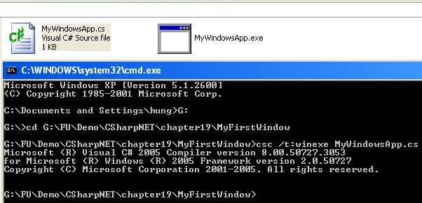
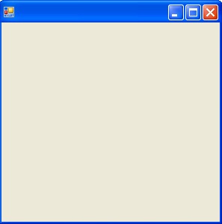

Slide 9
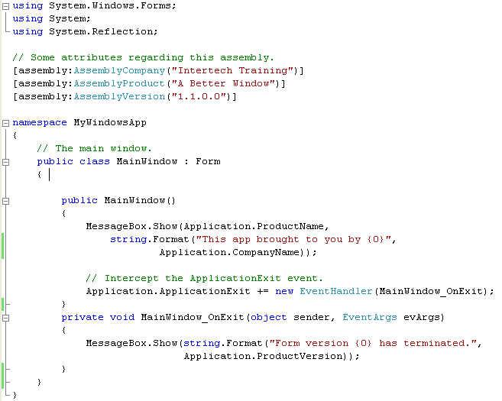
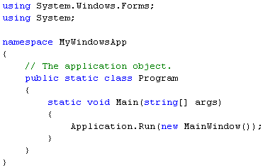
Windows application with Events
Ex: chapter19\AppClassExample
Notes:
[Serializable] public delegate void EventHandler( object sender, EventArgs e );
Sender
The source of the event. (sender is whatever that fires the event)
e
An EventArgs that contains the event data.
Remarks
The event model in the .NET Framework is based on having an event delegate that connects an event with its handler. To raise an event, two elements are needed:
A class that holds the event data. This class must derive from the base class EventArgs.
A delegate that points to a method that provides the response to the event.

Slide 10

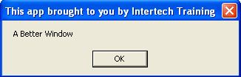
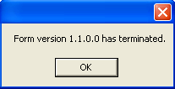
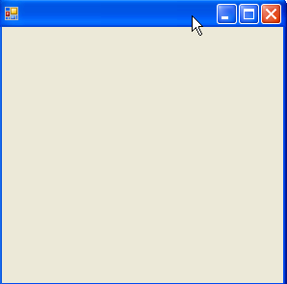
3
1
2

Slide 11
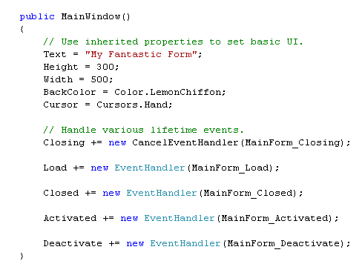
The Life Cycle of a Form Type
Load: init child components
Activate: the main windows receives focus
May happen many times
Deactivate: the main windows loses focus
Closing: usually use to as user to save data, and so on
Closed: the main windows terminates
Ex: Ch_19 Code\FormLifeTime

Slide 12
Events of the Control Type
Events | Description
Click, DoubleClick, MouseEnter, MouseLeave, MouseDown, MouseUp, MouseMove, MouseHover, MouseWheel | Various events that allow you to interact with the mouse
KeyPress, KeyUp, KeyDown | Various events that allow you to interact with the keyboard
DragDrop, DragEnter, DragLeave, DragOver | Various events used to monitor drag-and-drop activity
Paint | This event allows you to interact with GDI+ (see Chapter 20)

Slide 13
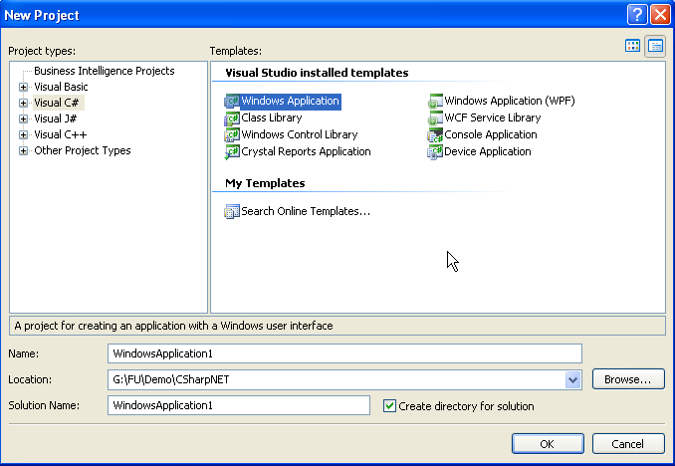

Building Windows Applications with Visual Studio 2005
2
1

Slide 14
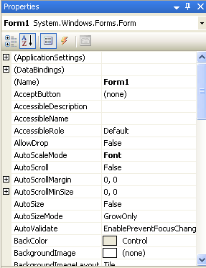
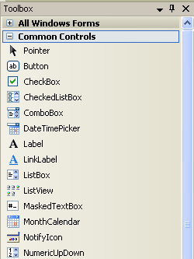
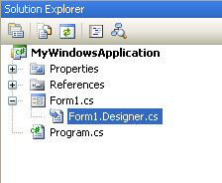
Building Windows Applications with Visual Studio 2005
The Visual Studio 2005 Toolbox
The Visual Studio 2005 Properties window
Notes:
Apartment Threading (Single Threaded Apartment)
Apartment threaded means there are multiple threads within the application. In single threaded apartment (STA) each thread is isolated in a separate apartment underneath the process. The process can have any number of apartments that share data through a proxy. The application defines when and for how long the thread in each apartment should execute. All requests are serialized through the Windows message queue such that only a single apartment is accessed at a time and thus only a single thread will be executing at any one time. STA is the threading model that most Visual Basic developers are familiar with because this is the threading model available to VB applications prior to VB.NET. You can think of it like an apartment building full of a row of one room apartments that are accessible one at a time through a single hallway. The advantage this provides over single threaded is that multiple commands can be issued at one time instead of just a single command, but the commands are still sequentially executed.

Slide 15
MenuStrips and ContextMenuStrips
Common UI elements that may be contained within a MenuStrip:
ToolStripMenuItem: A traditional menu item
ToolStripComboBox: An embedded ComboBox
ToolStripSeparator: A simple line that separates content
ToolStripTextBox: An embedded TextBox
Note: when the ampersand character (&) is placed before a letter in a menu item, it denotes the item’s shortcut key. In this example, you are creating &File and E&xit; therefore, the user may activate the Exit menu by pressing Alt+f, and then x.

Slide 16
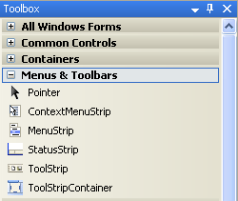
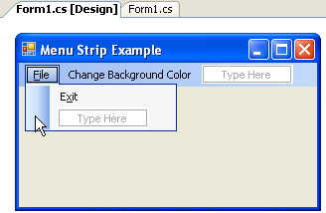
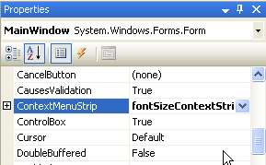
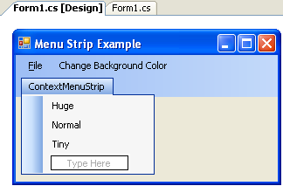
MenuStrips and ContextMenuStrips Demo
2
1
4
3
Ex: Ch_19 Code\MenuStripApp

Slide 17
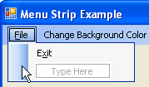

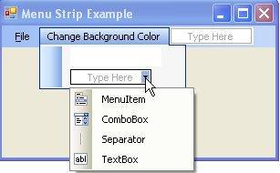
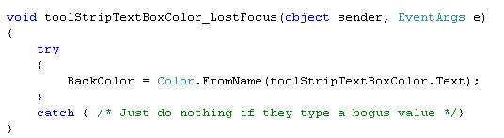
MenuStrips and ContextMenuStrips Demo

Slide 18
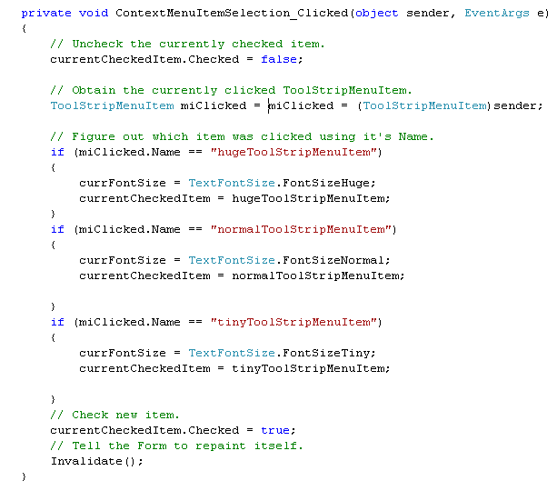
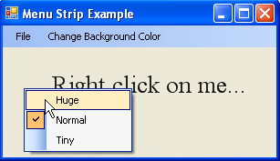
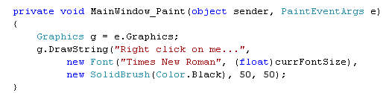
MenuStrips and ContextMenuStrips Demo

Slide 19
Working with StatusStrips
Status strips have the ability to contain additional tool strip items such as the following:
ToolStripProgressBar: An embedded progress bar.
ToolStripDropDownButton: An embedded button that displays a drop-down list of choices when clicked.
ToolStripSplitButton: This is similar to the ToolStripDropDownButton, but the items of the drop-down list are displayed only if the user clicks directly on the drop-down area of the control. The ToolStripSplitButton also has normal buttonlike behavior and can thus support the Click event.

Slide 20
Working with ToolStrips
Example: ToolStripApp

Slide 21
Building an MDI Application
MDI applications allow users to have multiple child windows open at the same time within the same topmost window.
In the world of MDIs, each window represents a given “document” of the application.
Given that Forms are class types, any private data defined in the child Form will be unique to a particular instance.
Example, if you were to create an MDI word processing application, you might create a child Form that maintains a StringBuilder to represent the text. If a user created five new child windows, each Form would maintain its own StringBuilder instance, which could be individually manipulated.
Notes:
MDI: multiple document interface

Slide 22
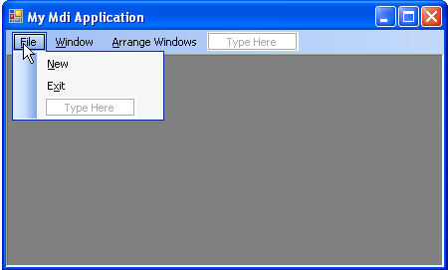
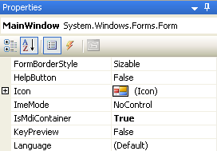
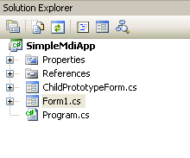
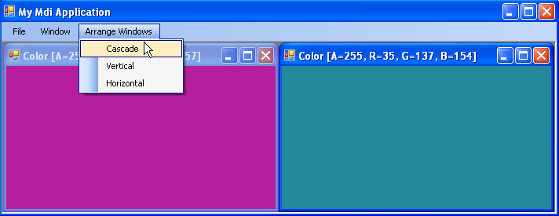
MDI Form Demo (Ch_19 Code\SimpleMdiApp)

Slide 23
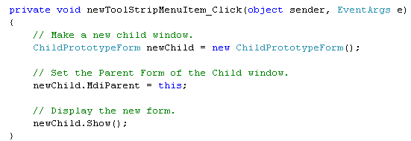
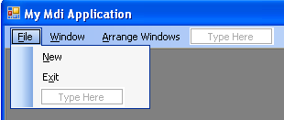
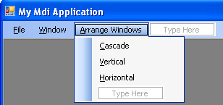
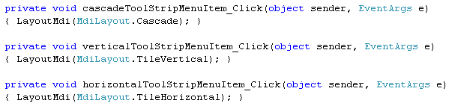
MDI Form Demo (Ch_19 Code\SimpleMdiApp)

Slide 24
Summary
MenuStrips and ContextMenuStrips
StatusStips
MDI applications

Slide 25
Chapter 19: Q & A

